Slide 1
ENSE 374, Milestone 4
The Great Value
Azeezat, Krupal, Joseph, Clark, Martha
November 15, 2018

Slide 2
Content Strategy
Key Page Substance - What kind of content and for what kind of audience?
The content is what we believe are the requirements for the engineering faculty webpage
Easy access to forms and other files
Easy to find and navigate
Navigation structure - Organization, prioritization, format, display
Overhead navigation bar
Sidebar navigation structure - shows the second level
Governance/security
We have a login page to separate the executives from the professors and the staff

Slide 3
Lo-Fi Prototype
Notes:
Go over key findings from your content review and analysis Might be interesting to look at each of the main sections at a high-level first and then dive into the details Engineering home Programs Students Faculty & Staff directory Contact us

Slide 4
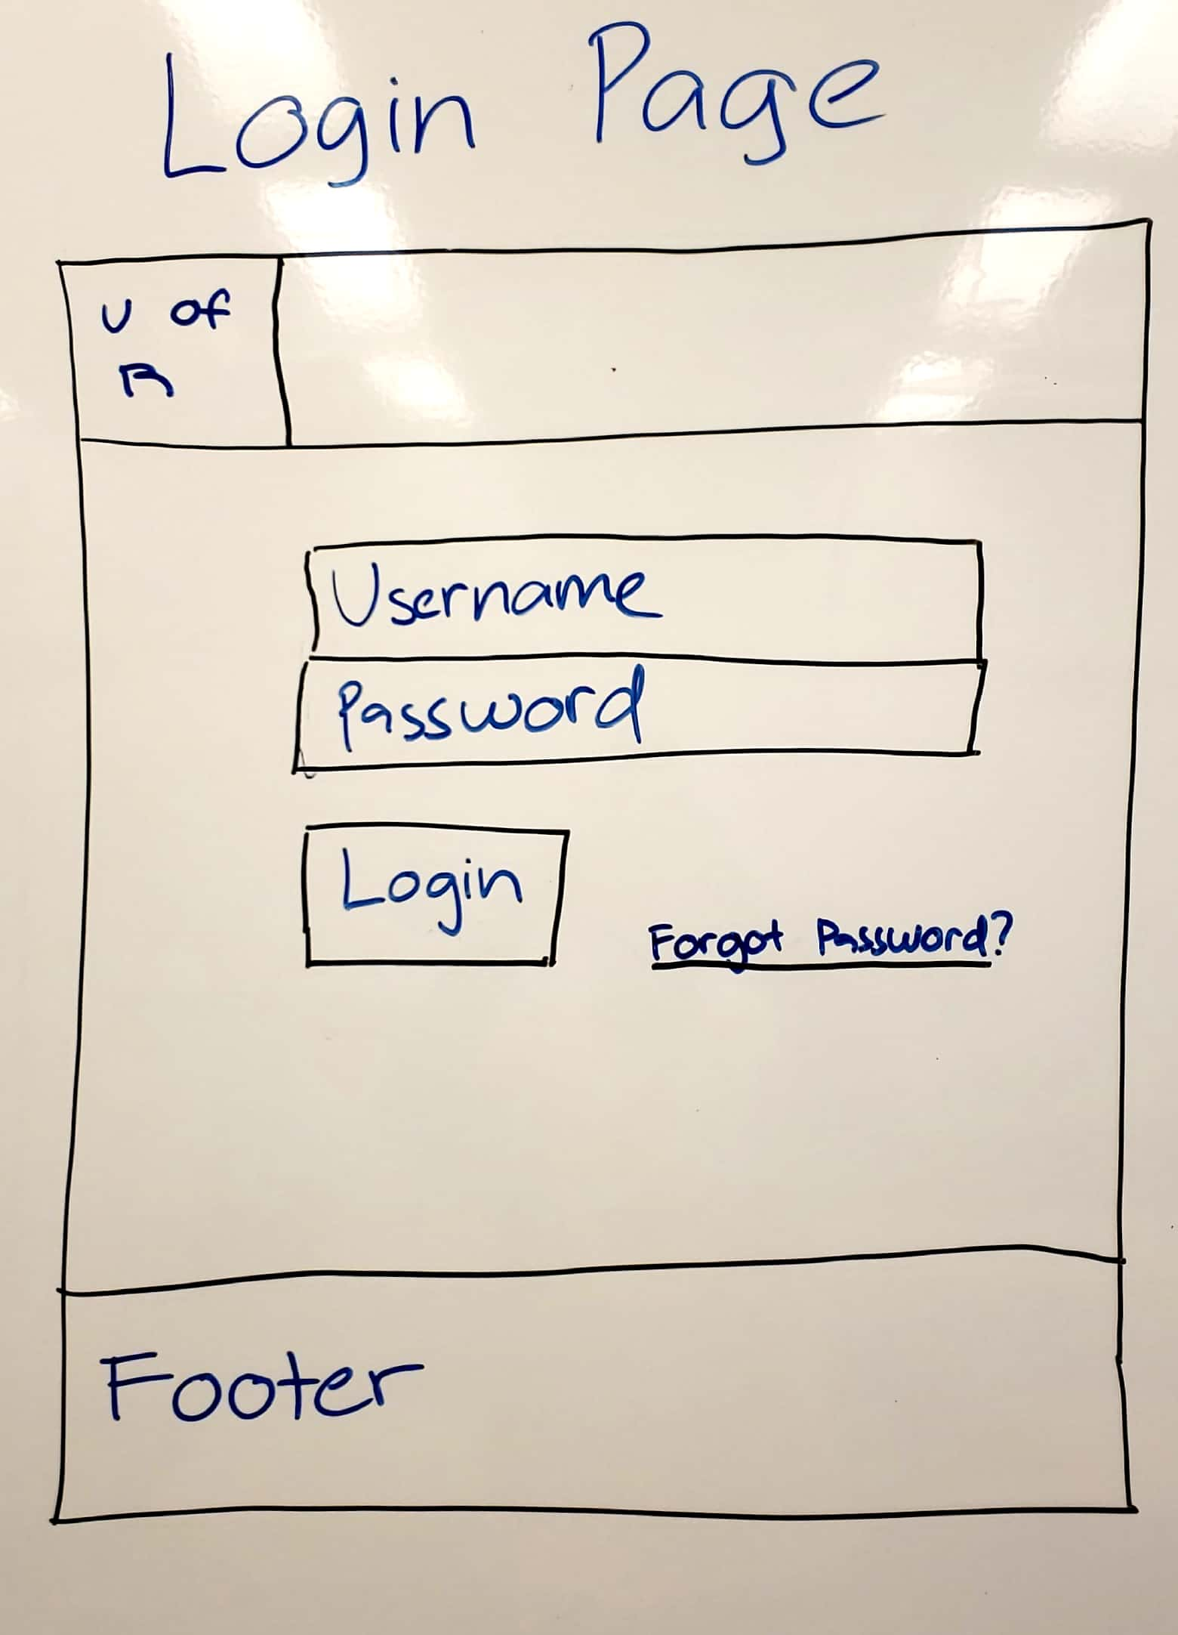
Notes:
Go over key findings from your content review and analysis Might be interesting to look at each of the main sections at a high-level first and then dive into the details Engineering home Programs Students Faculty & Staff directory Contact us

Slide 5
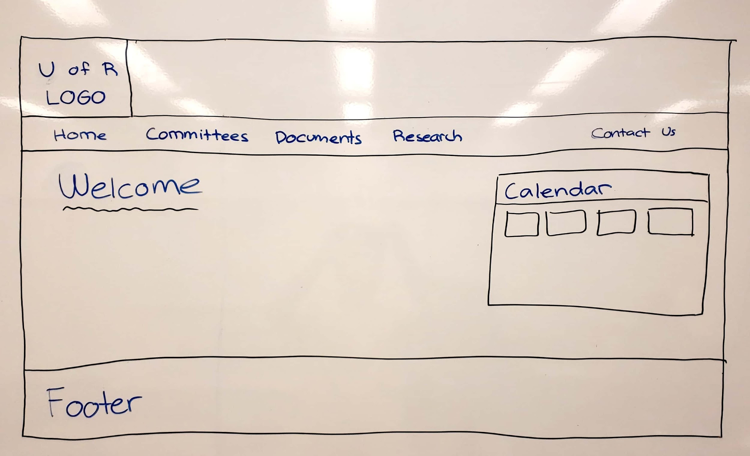

Slide 6
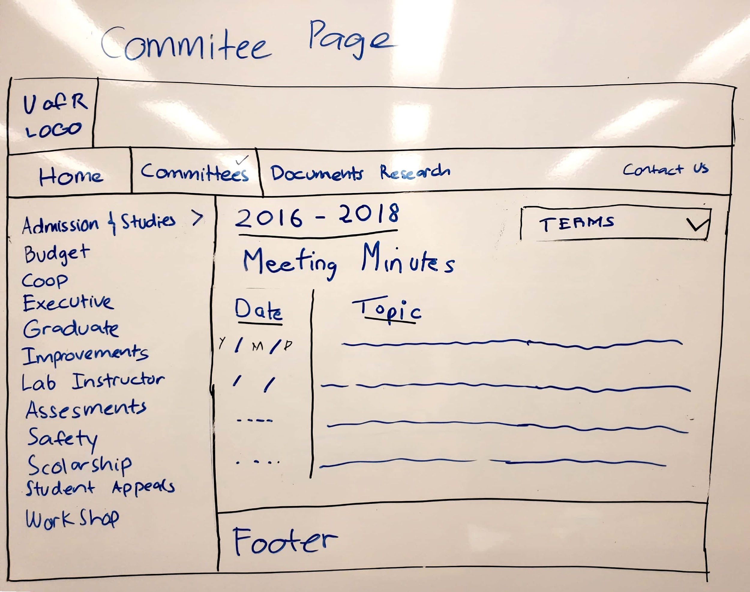

Slide 7
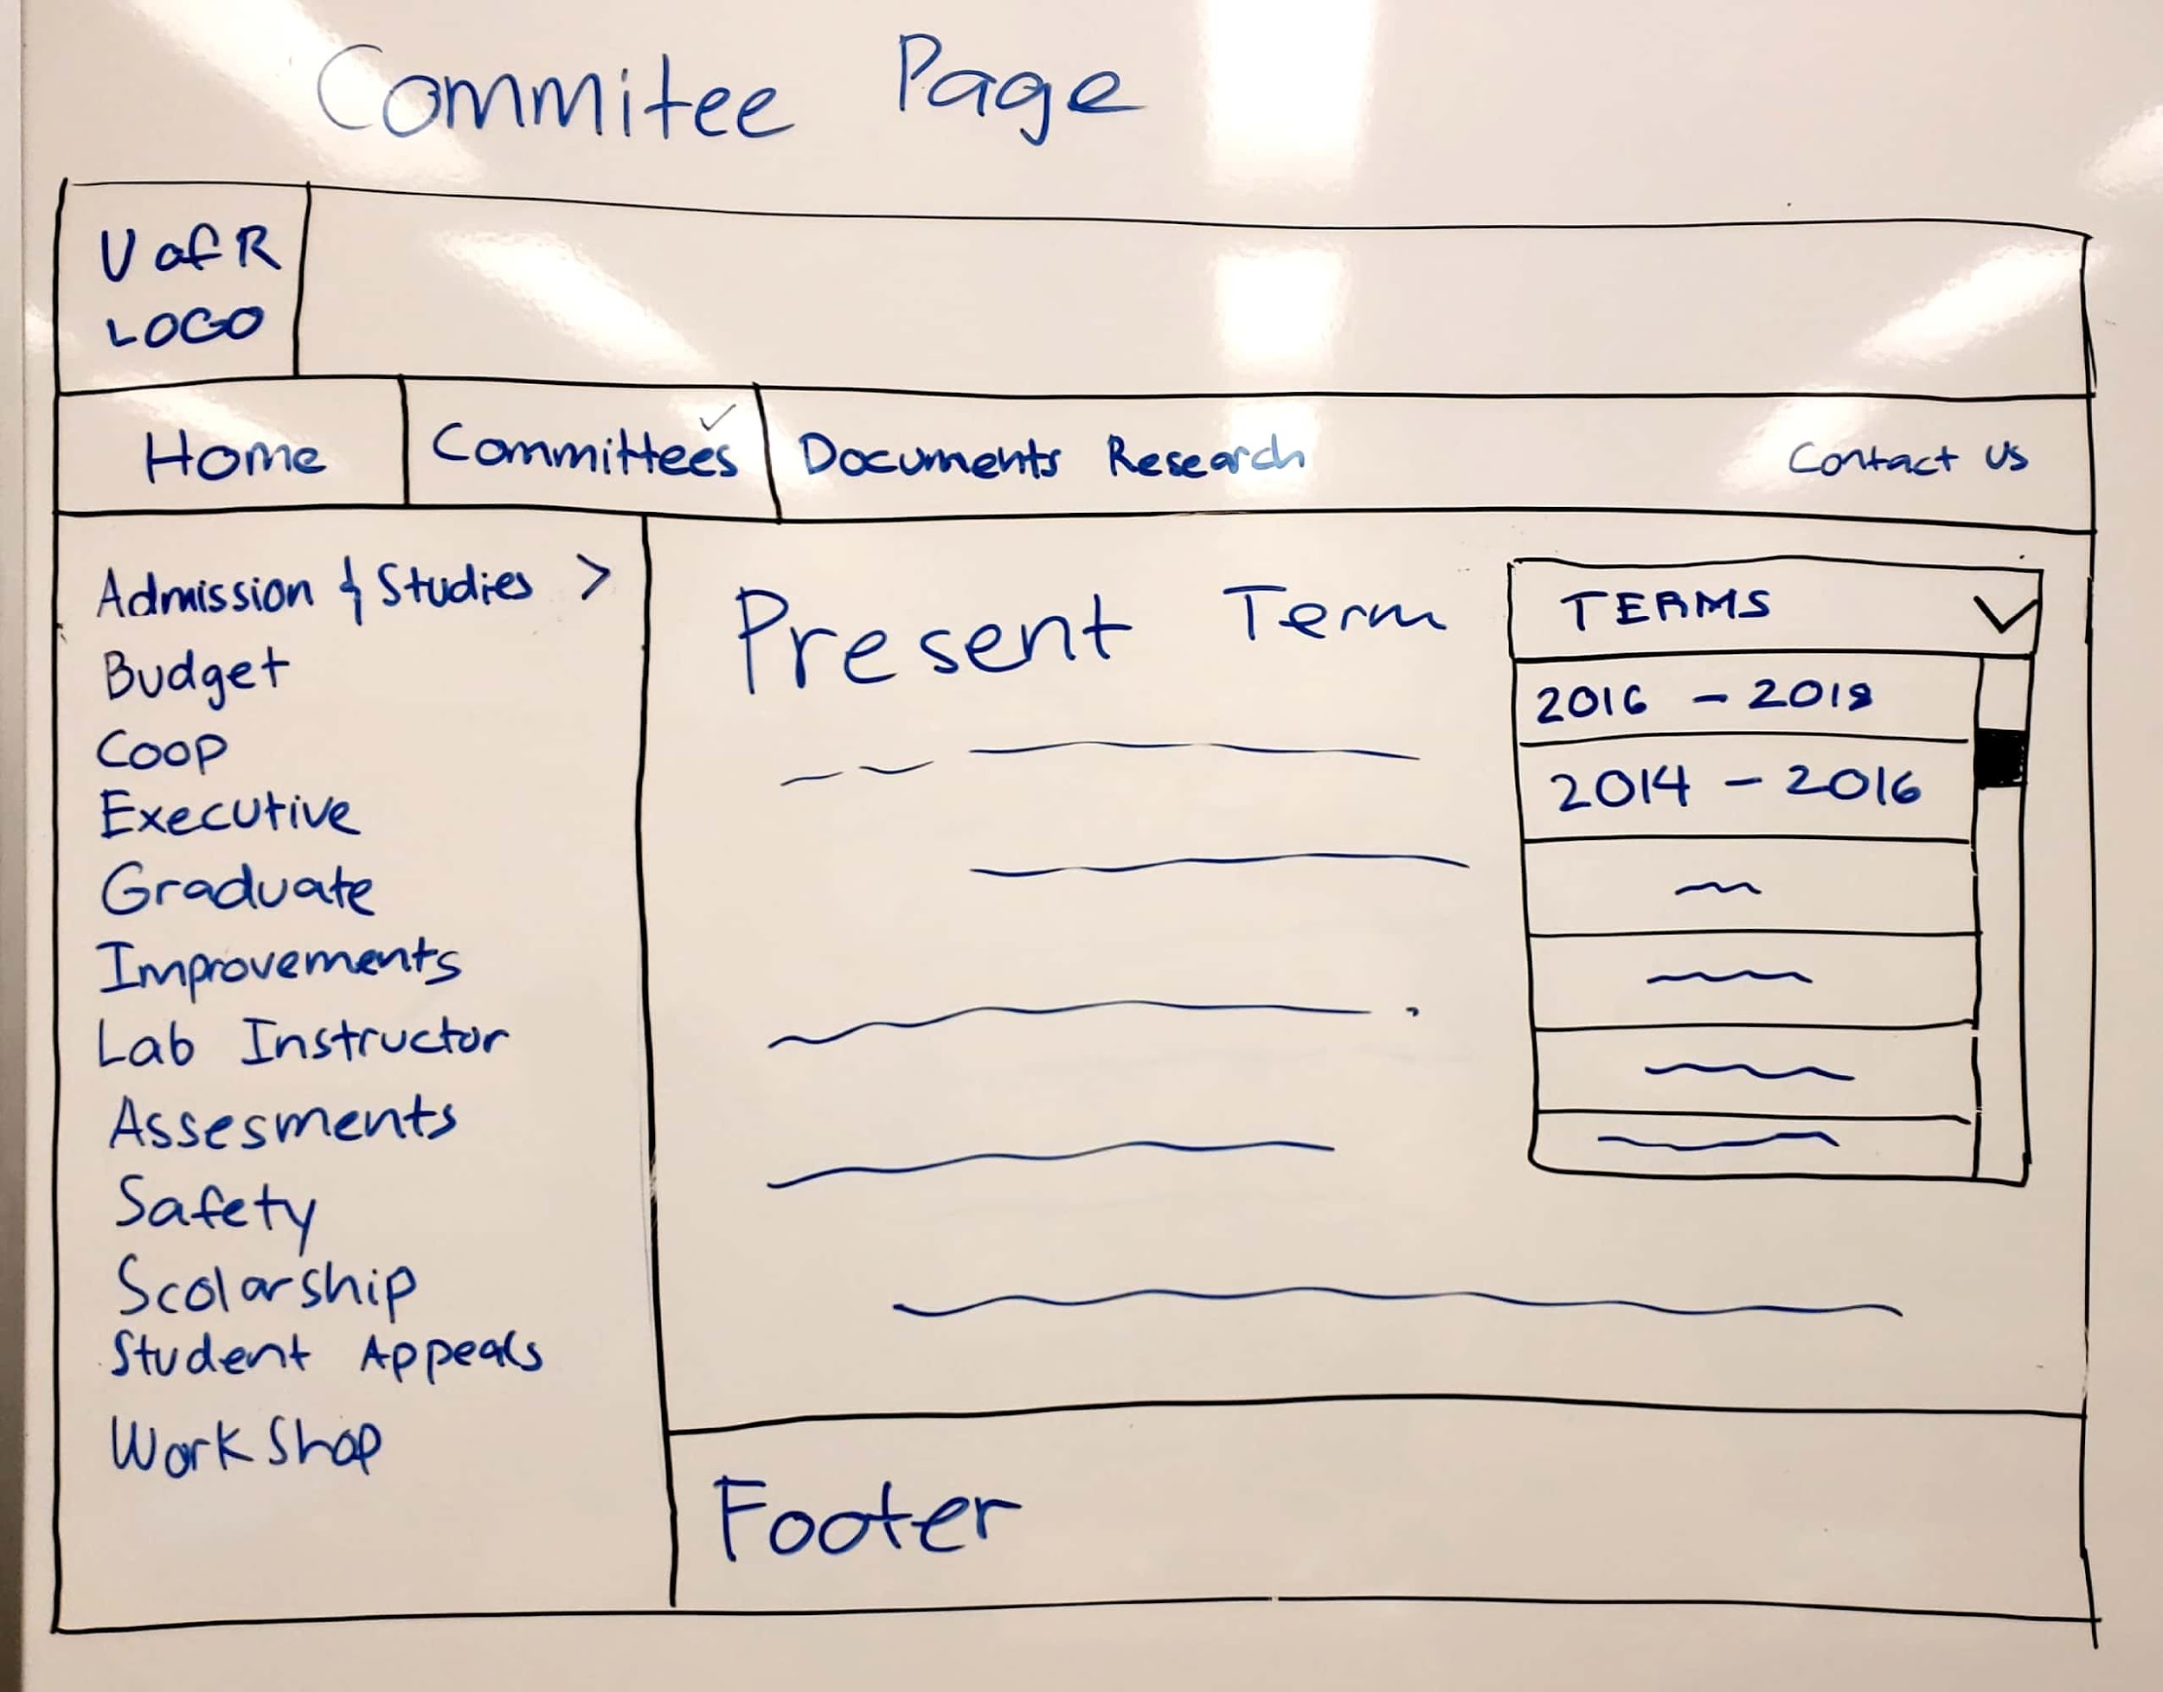

Slide 8
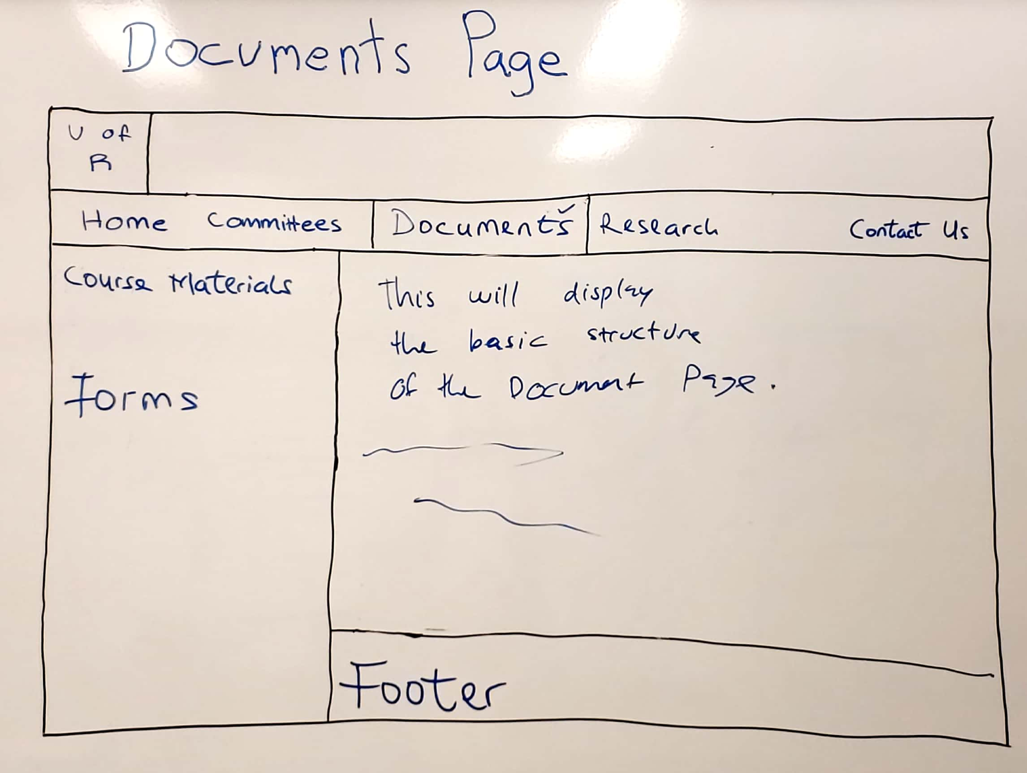

Slide 9
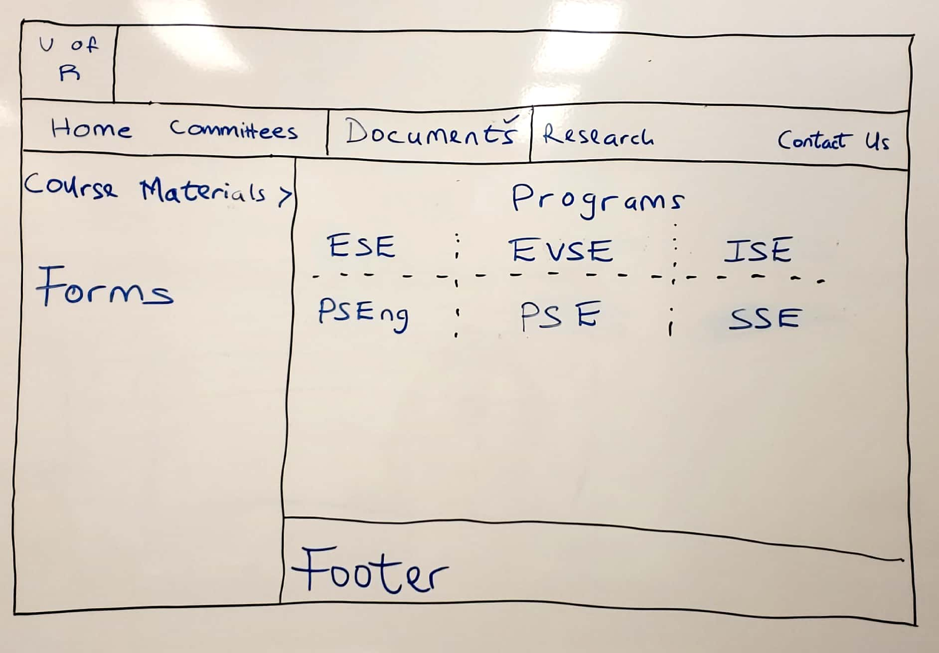

Slide 10
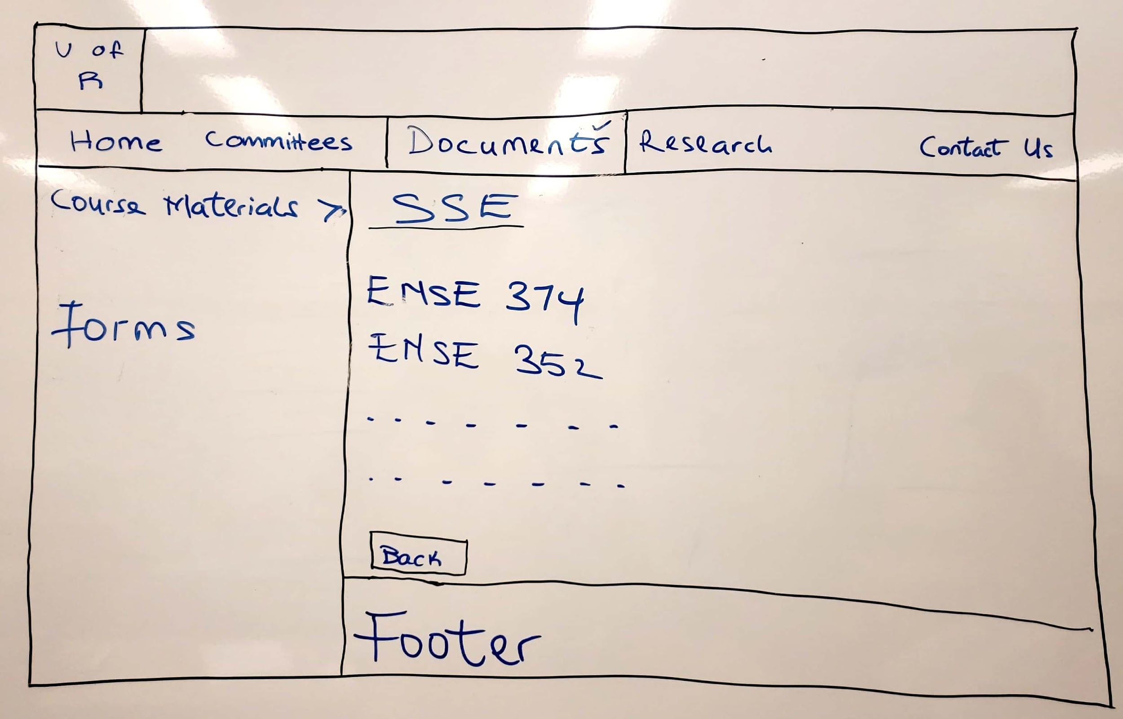

Slide 11
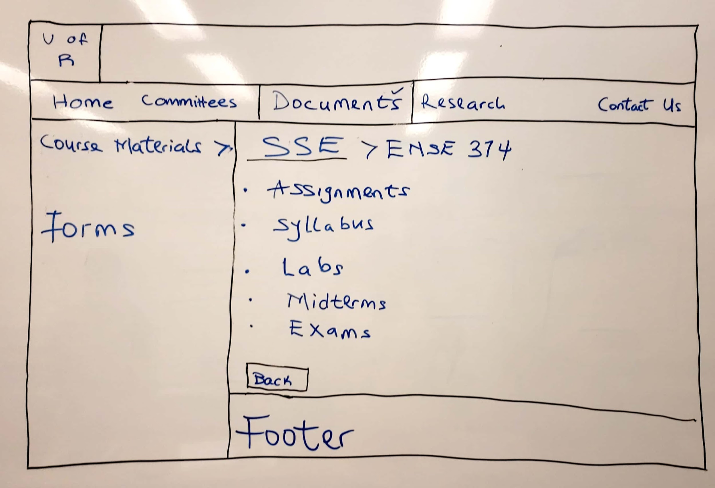

Slide 12
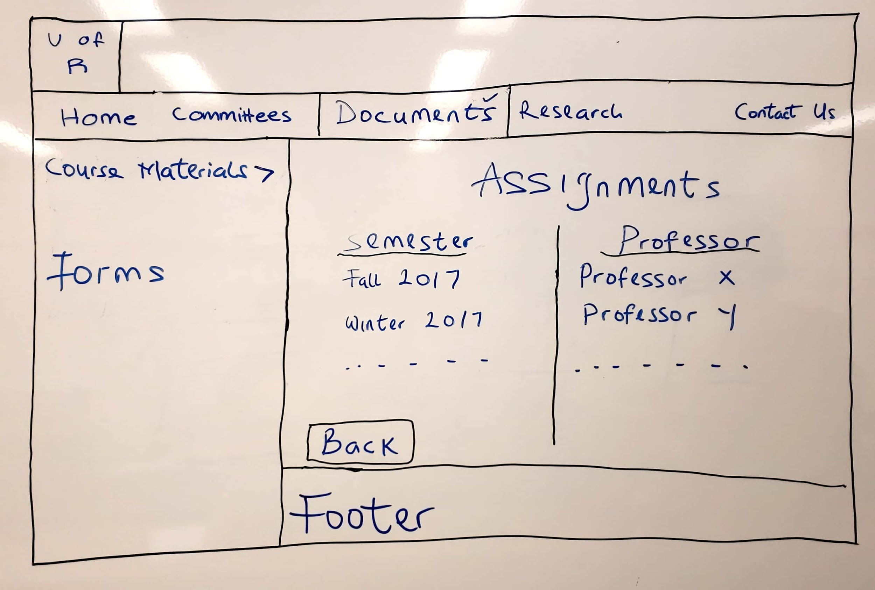

Slide 13
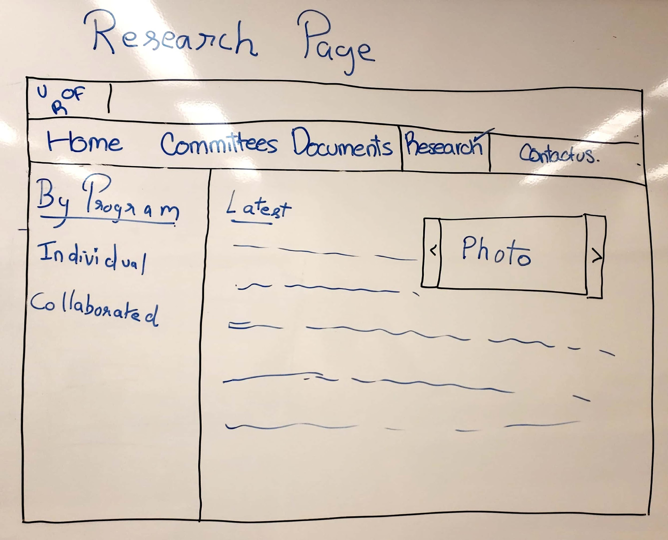

Slide 14
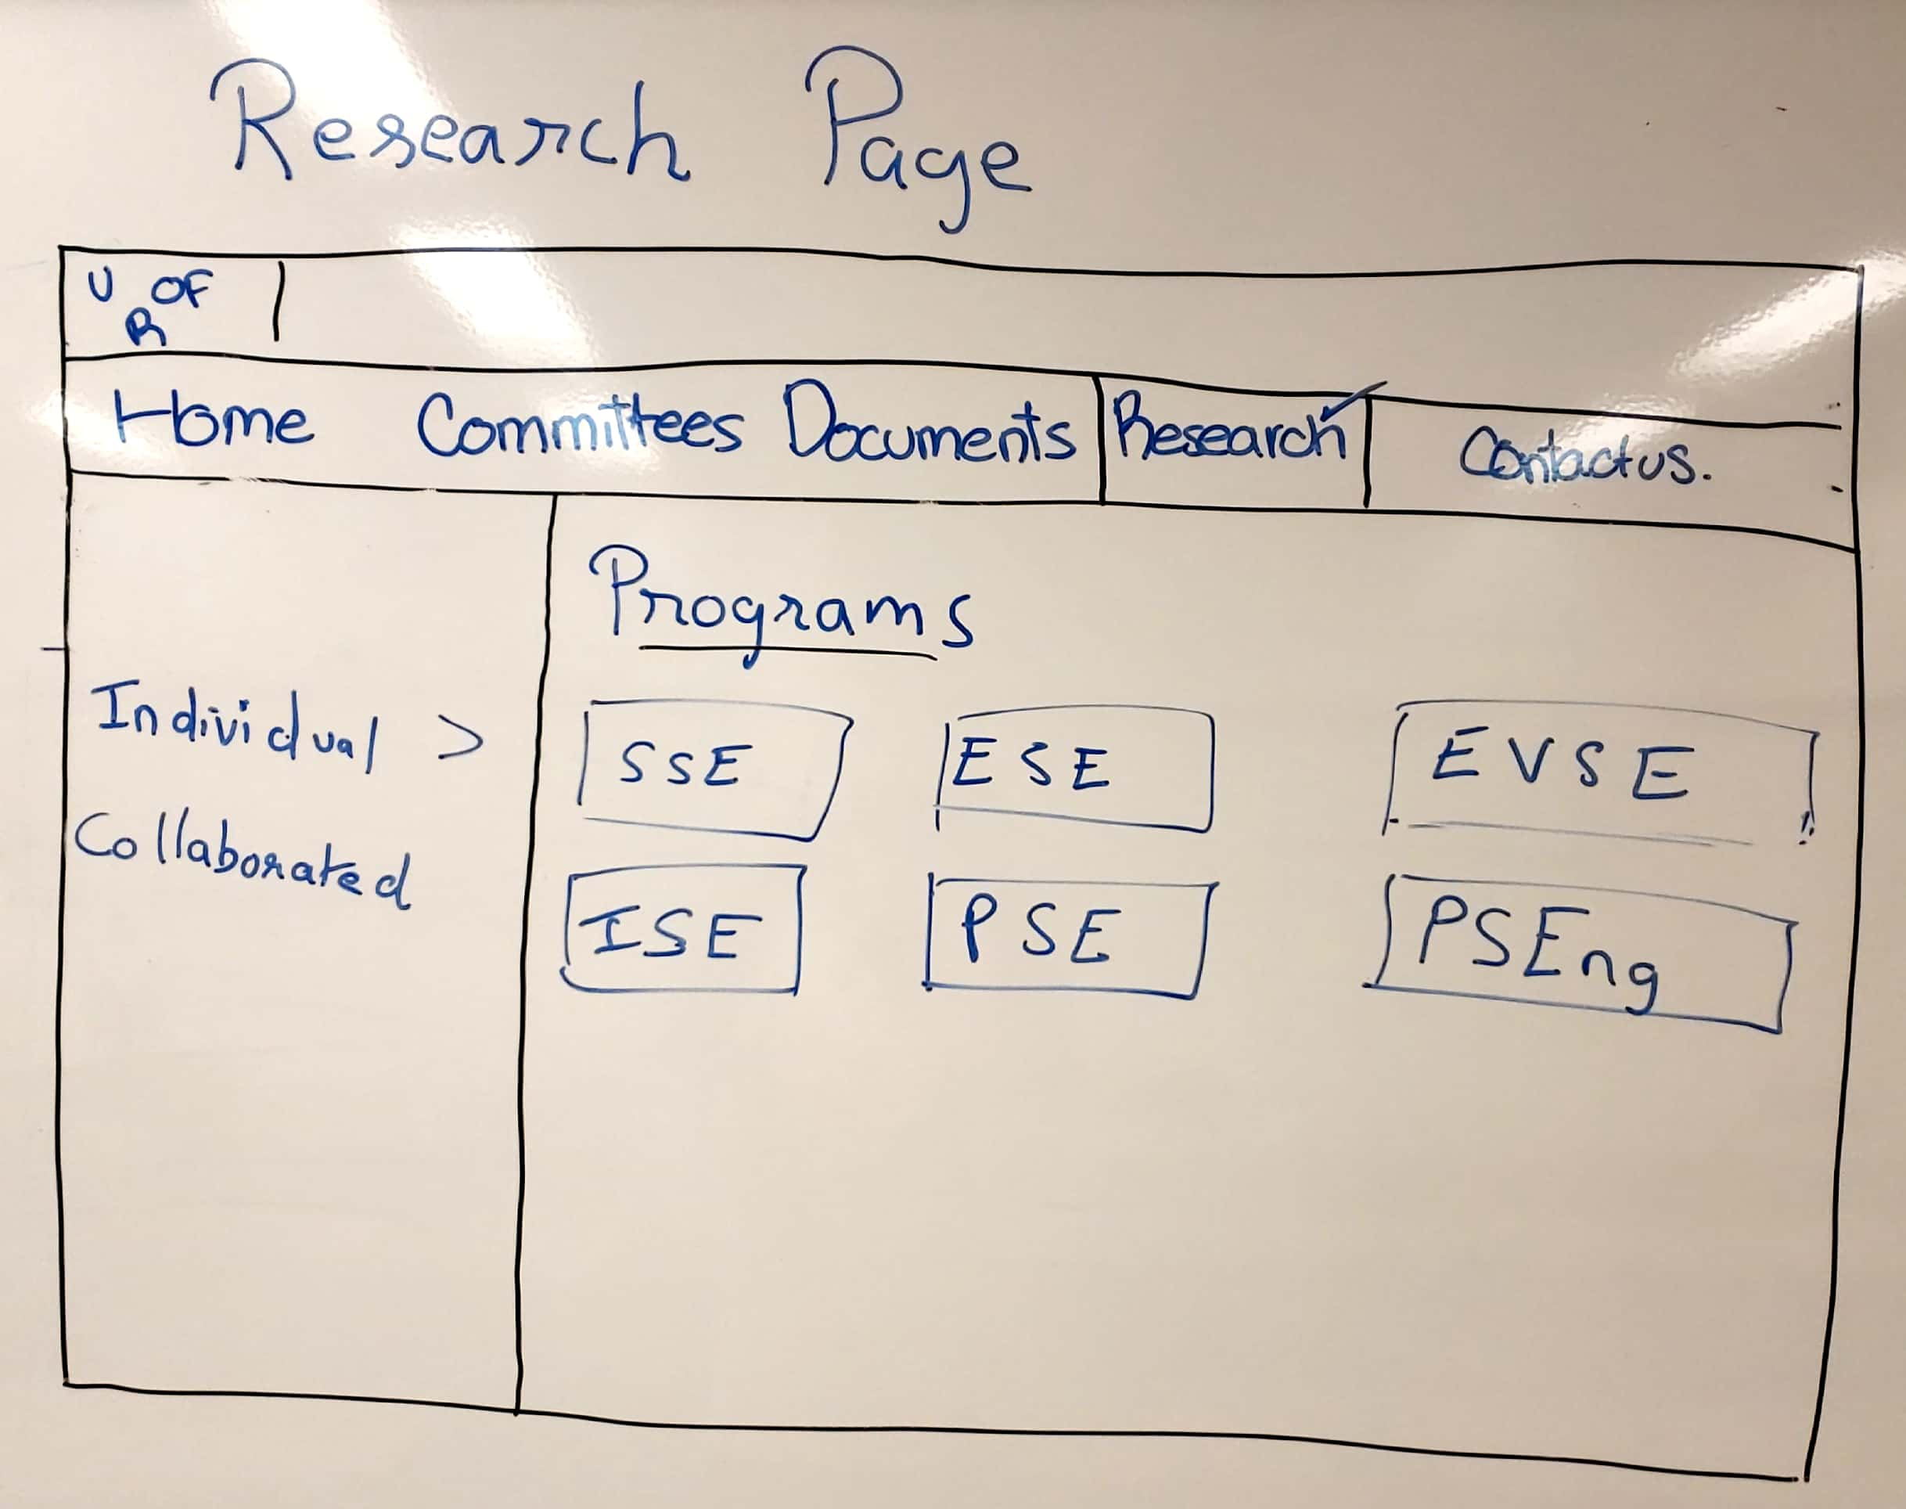

Slide 15
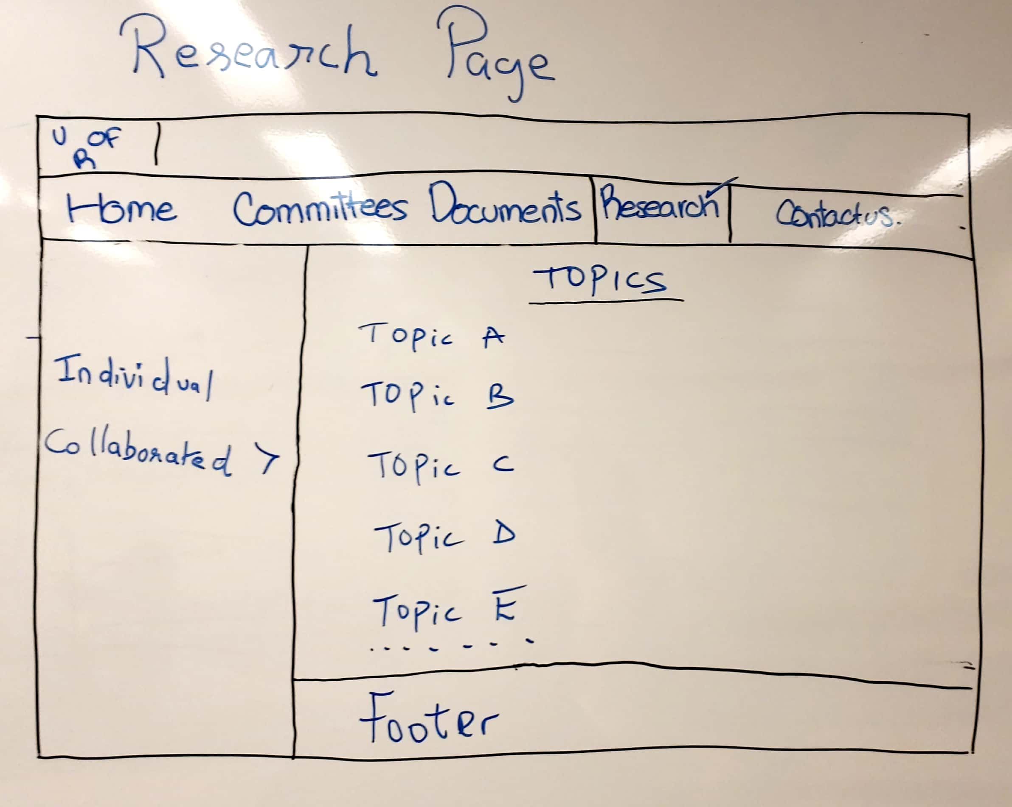

Slide 16
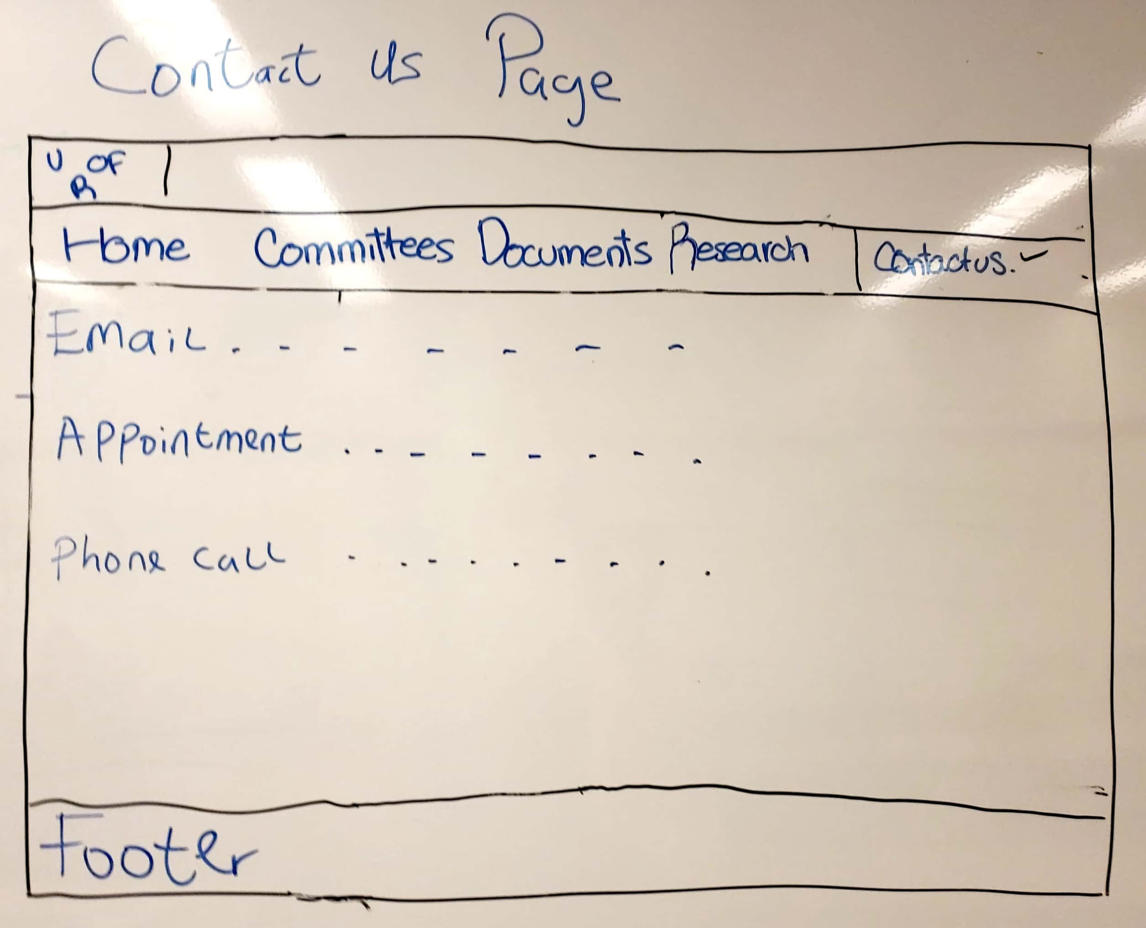
Notes:
Go over key findings from your content review and analysis Might be interesting to look at each of the main sections at a high-level first and then dive into the details Engineering home Programs Students Faculty & Staff directory Contact us

Slide 17
User Questionnaire - Pre-Task
How would they expect it to look?
Before users even look at the wireframe or prototype, what would they expect to be able to do with it?
What comes to your mind when looking about our website?
Notes:
https://www.usertesting.com/blog/31-questions-every-designer-should-ask-when-testing-prototypes/

Slide 18
User Questionnaire - Task
Find Internship forms
Find Graduate Committee meeting minutes
Find Prof B’s research documents
Find ENSE 374 midterm during Fall 2016
Notes:
Once you show them the prototype, do users understand what it does?

Slide 19
User Questionnaire - Post-Task
What was your first impression of this prototype?
What features are missing?
Does anything seem redundant or unnecessary?
How does the prototype measure up to your expectations?
How did you feel about using this prototype?
What would you like to change about the prototype?
How likely/unlikely would you want to use the website once its finished?
How would you rate this webpage?
Notes:
Go over key findings from your content review and analysis Might be interesting to look at each of the main sections at a high-level first and then dive into the details Engineering home Programs Students Faculty & Staff directory Contact us

Slide 20
User Questionnaire - Data Collection
We want to know if we deleted folders that is important for the staff members. Are there features they need that are missing in our prototype?
Collecting this will produce value so we can add the features they want/need. The user is the most important part of this and we want to make sure they are content and satisfied.
Notes:
Chat about what data you hope to collect and why you think collecting it will provide value to evolving your proposed content strategy/intranet design

Slide 21
Cascade Server Progress
We learned all the basic functions of the Cascade server by reading the manual.
We made a trial webpage by incorporating what we learned, and made our navigation bar.
We don’t know how to create a login page for our users on cascade.

Slide 22
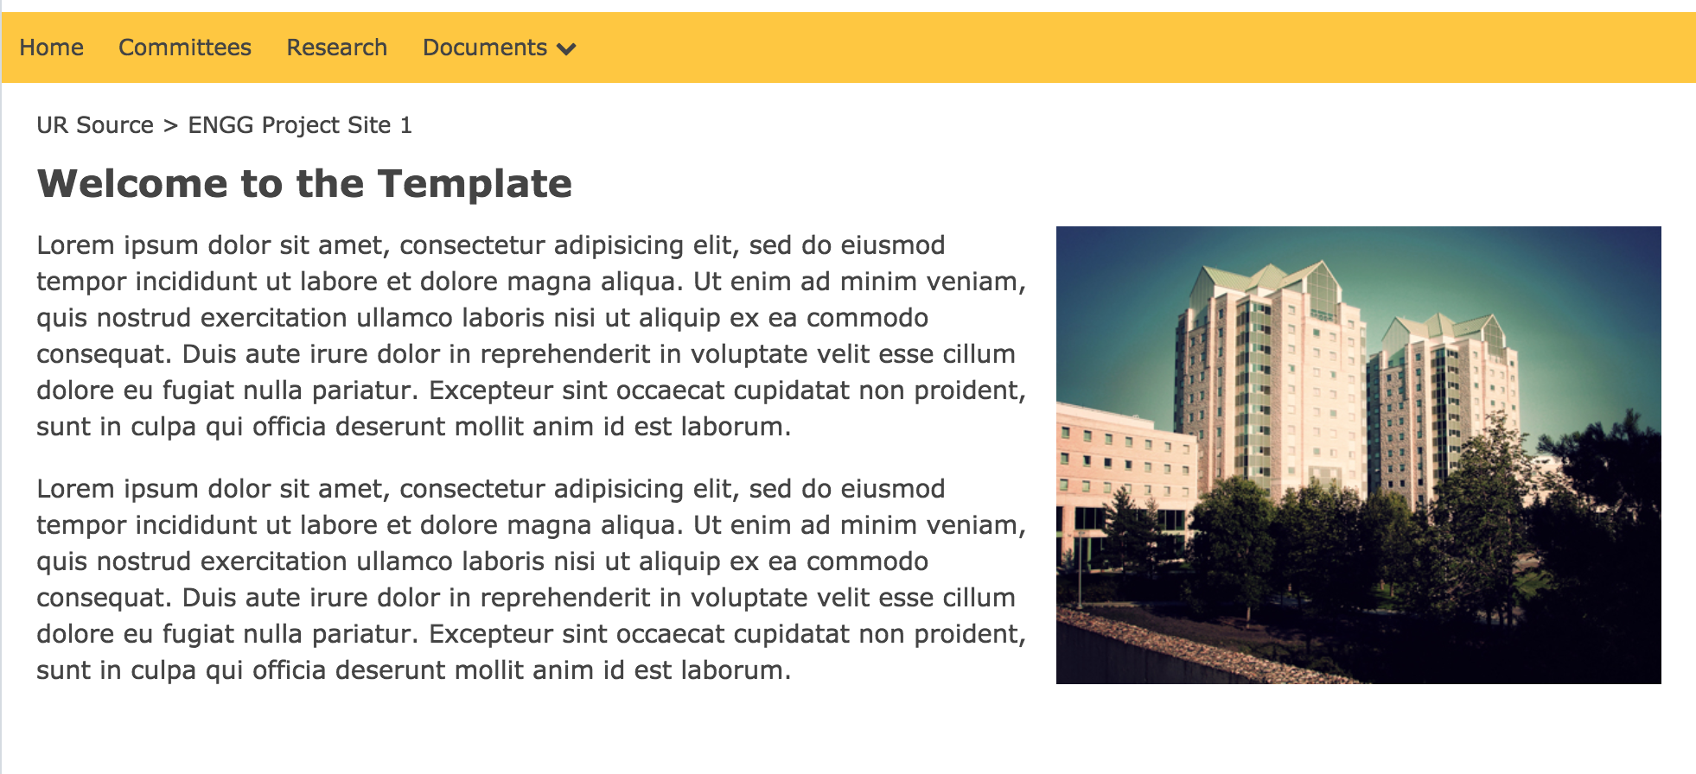

Slide 23
Miscellaneous
We tried to ask open-ended questions, rather than yes/no questions.
Notes:
Go over key findings from your content review and analysis Might be interesting to look at each of the main sections at a high-level first and then dive into the details Engineering home Programs Students Faculty & Staff directory Contact us

Slide 24

Group Reflection
About this milestone:
We loved this milestone; it was easier for us because all we had to do was incorporate everything we did in milestone 3 into a lo-fi prototype.
About ourselves:
We were able to find out the creative group members to figure out the best way to design our lo-fi prototype. Also, we need music, food, and coffee while working!
In the future:
We will incorporate what we learned about ourselves into future group meetings, and find out who does the best work in a particular instance.
Help needed?
Can we change the colour of the navigation bar? Is there a way to move the search bar up?
Image taken from: http://homeschoolcpa.com/board-turnover-may-mean-the-purpose-of-the-homeschool-group-could-change/
Notes:
How did you feel about this milestone? What did you like about it? What did you dislike?
What did you learn about yourselves as you collaborated and worked through this milestone?
How will you use what you have learned going forward?
What “stuff & things” related to this milestone would you want help with?

Slide 25
Questions?

